Slide 1
Anatolian Languages
Chris Guest

Slide 2
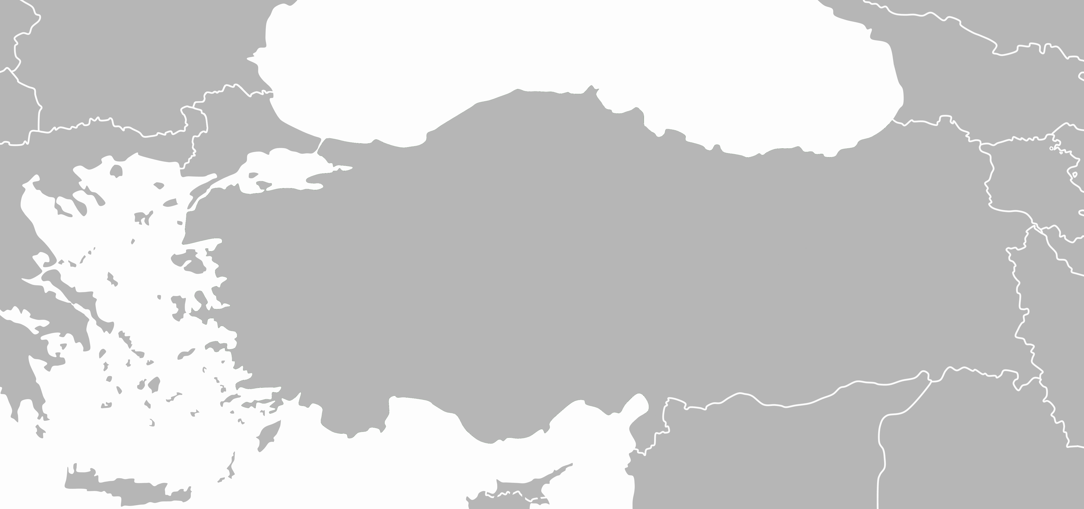
Anatolian Languages 1800-1200BC
Kalasmaic
Hattic
• Troy
• Hattusa
Hittite
Urartuan
Luwian
• Kanesha
Palaic
• Miletus
Hurrian
Mycenaen
Minoan

Slide 3
Anatolian Languages 800-200BC
Aeolian
• Troy
Mysian
Phrygian
Lydian
Ionian
Armenian
• Sardis
Carian
• Miletus
Pisidian
Dorian
Lycian
Sidetic
Luwian
Milyan

Slide 4
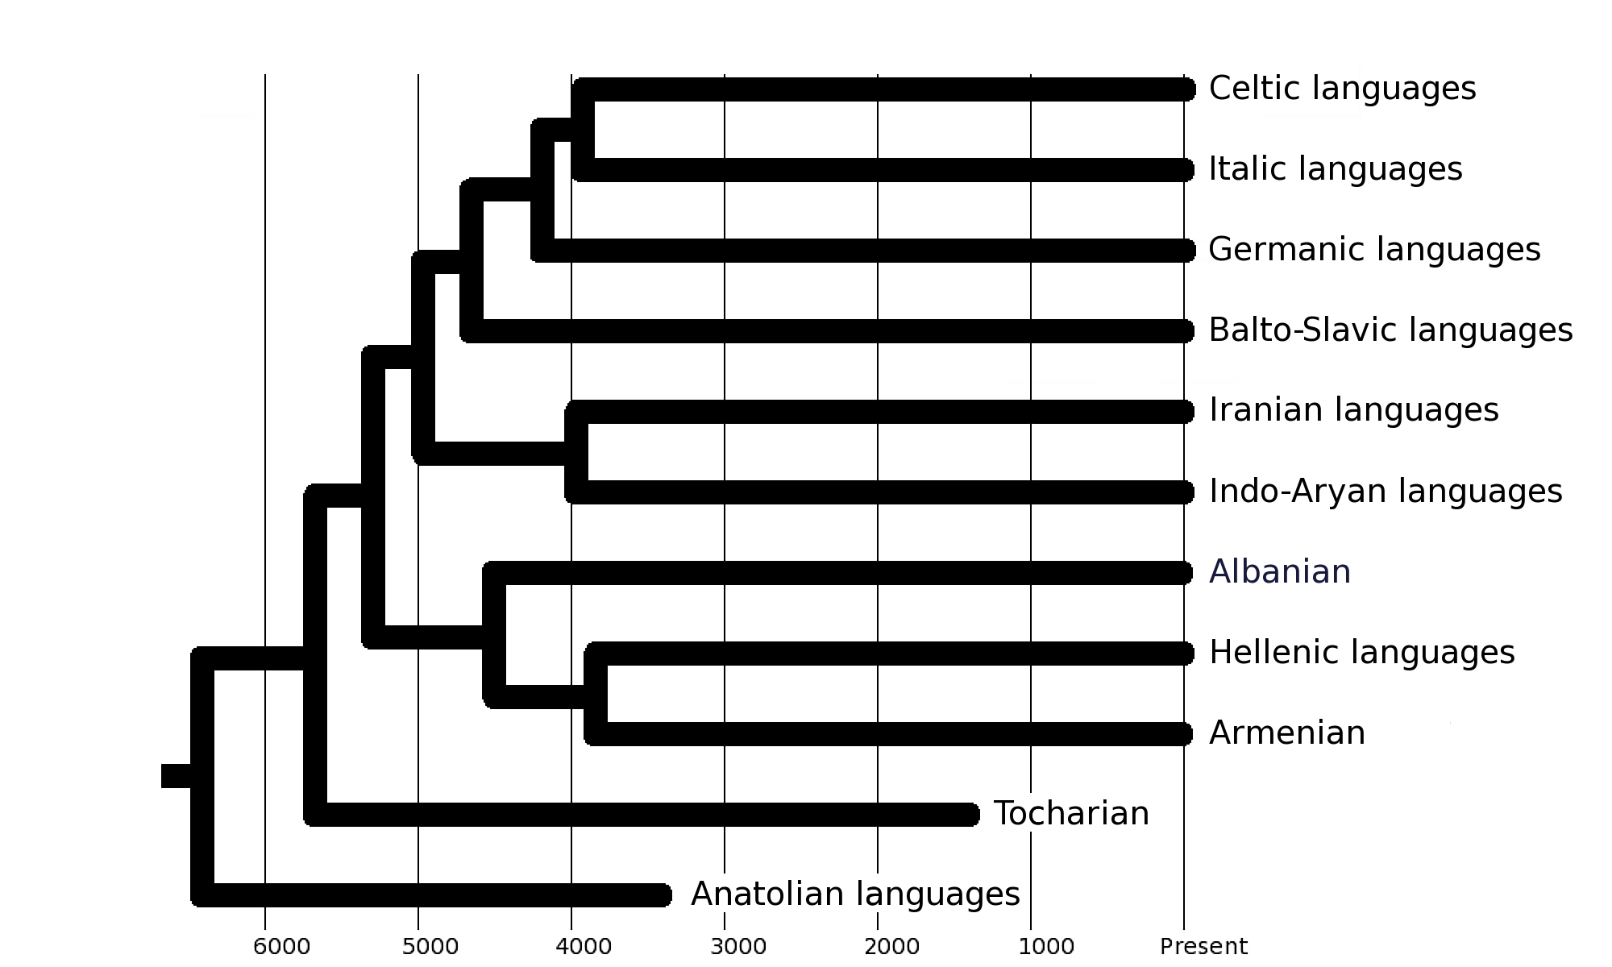
Indo-European languages

Slide 5
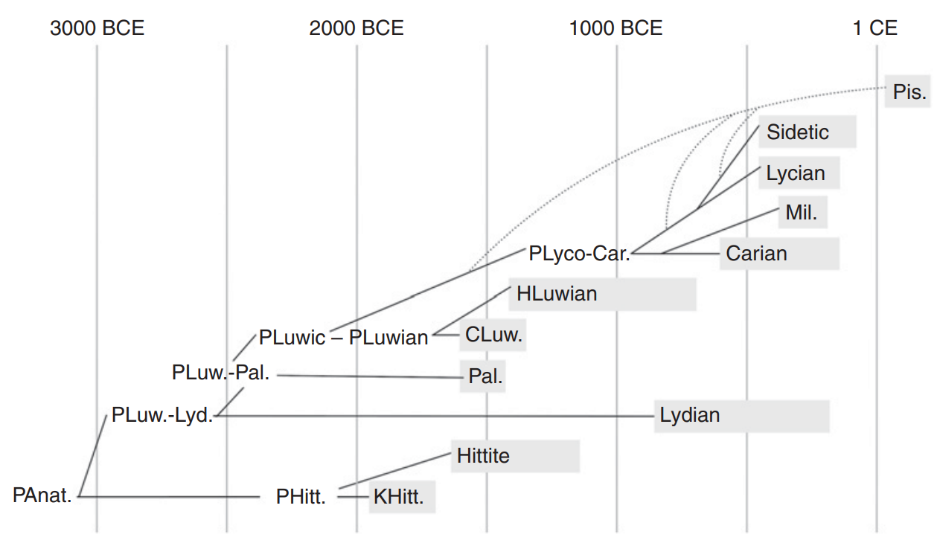
Anatolian Language Family
Source: Kloekhorst, Anatolian Languages in The Indo-European Language Family 2022

Slide 6
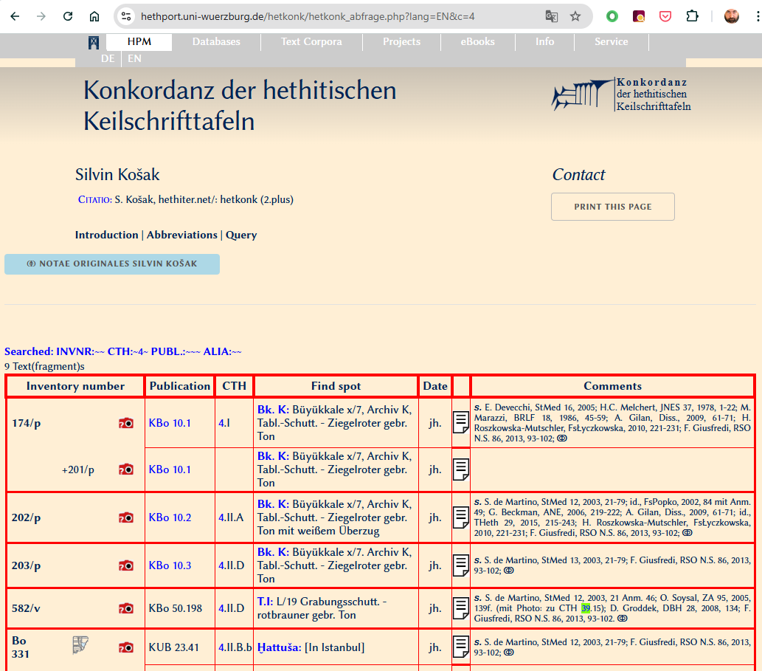
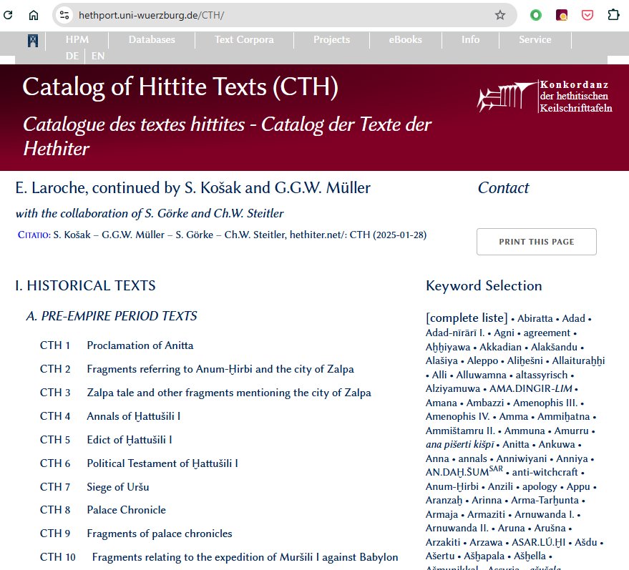
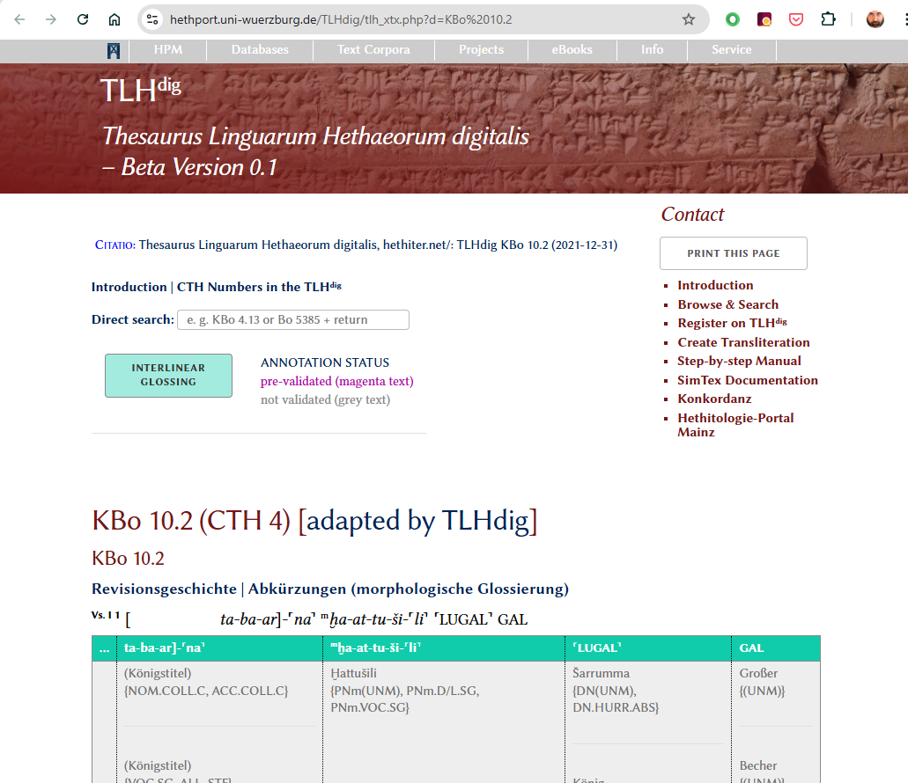
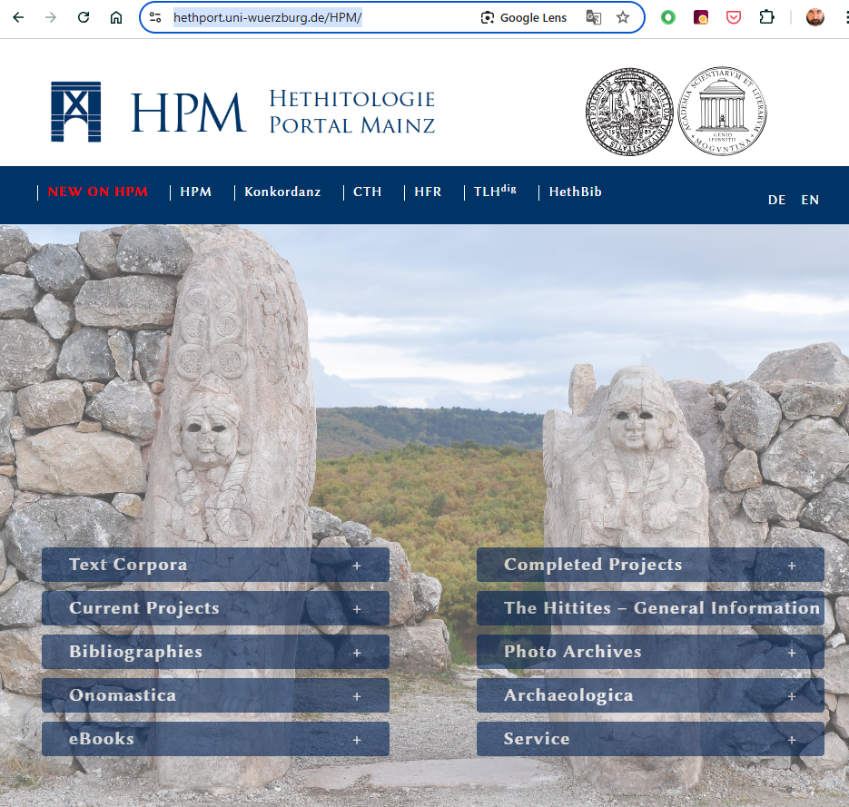
Hethitologie Portal Mainz

Slide 7
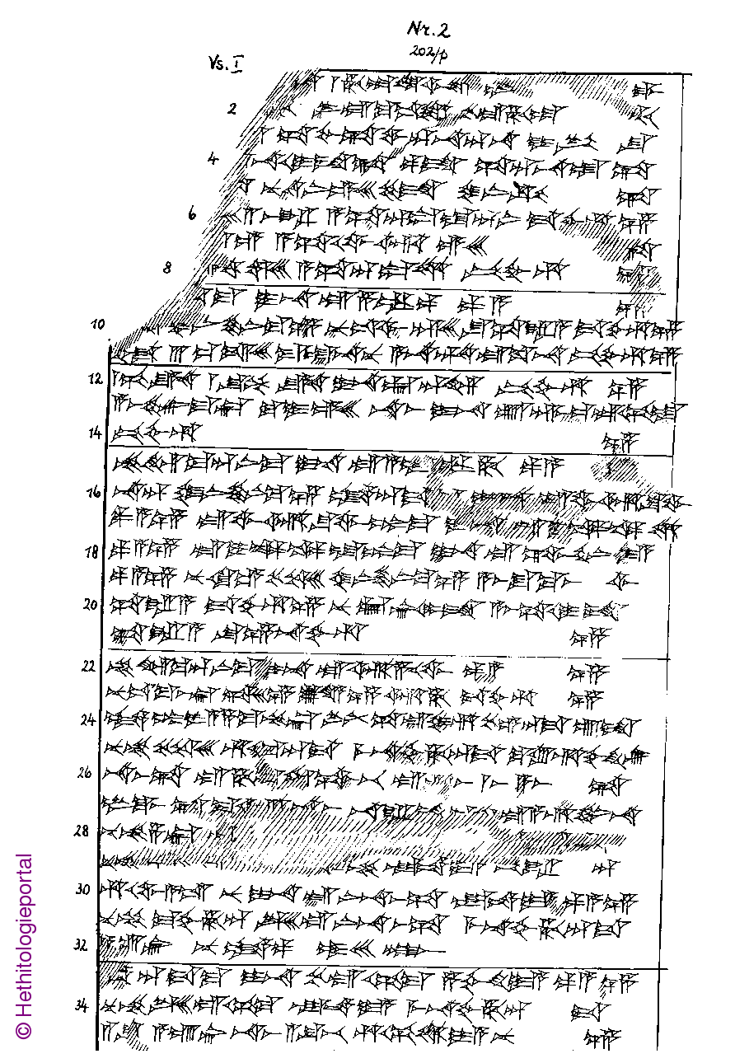
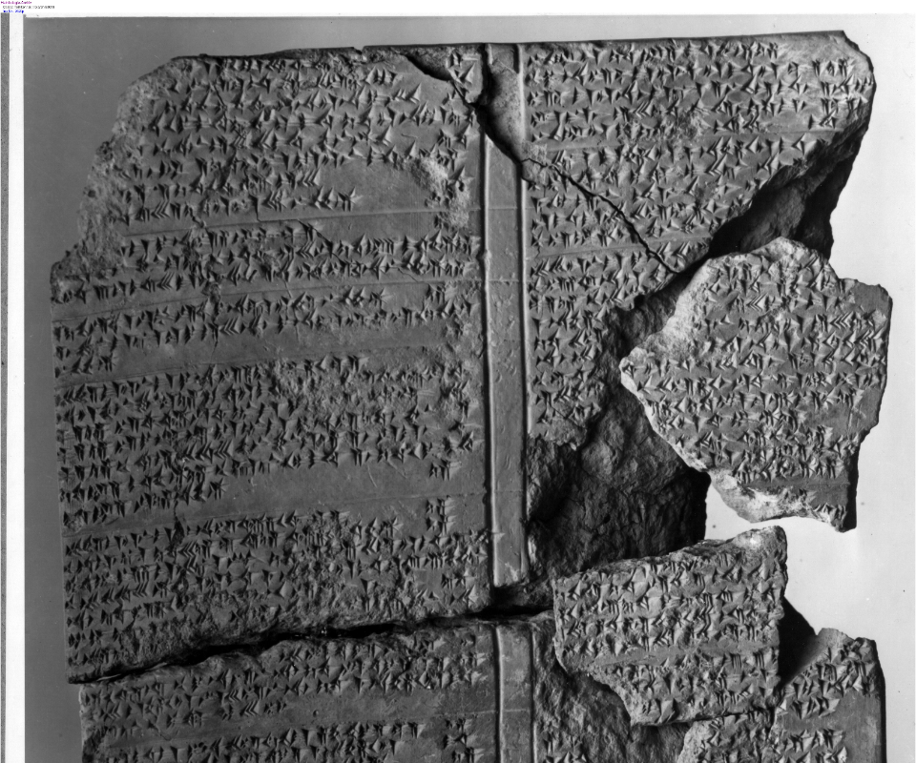
Hittite Cuneiform
CTH 4 Annals of Ḫattušili I - KBo 10.2

Slide 8
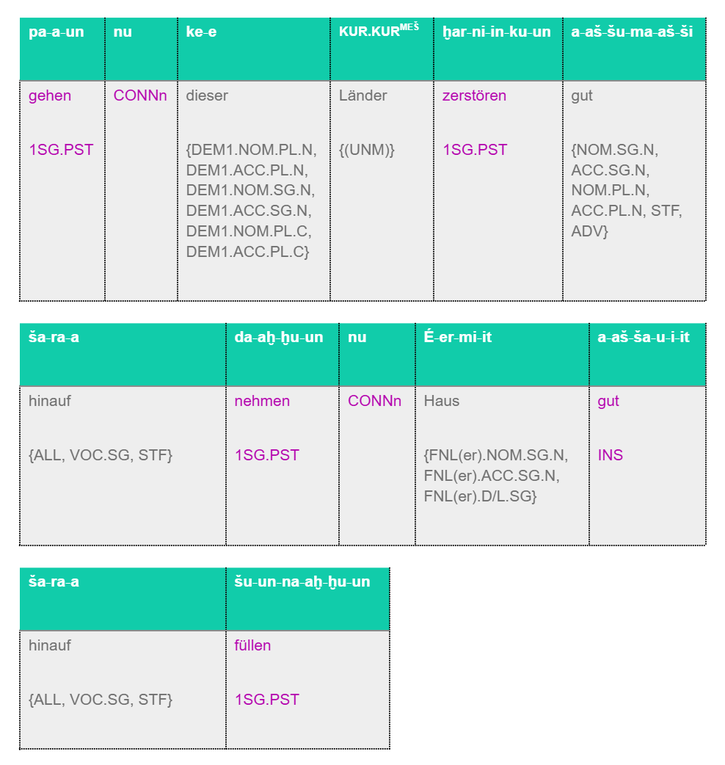
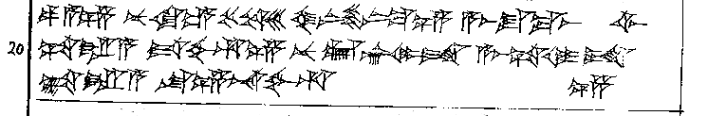
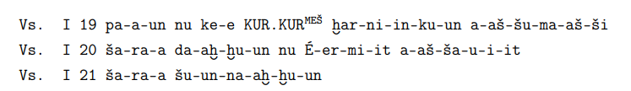
Hittite Resources
Autograph of KBo 10.2 lines 19-21
Transliteration of KBo 10.2 lines 19-21
hethport.uni-wuerzburg.de

Slide 9
Hittite Resources
Summary of Hethitologie Portal Mainz
18402 Texts
14640 with Transliterations
14515 with some Parts-of-Speech or translation glossing
Universal Dependency treebank
136 Sentences
1309 Words

Slide 10
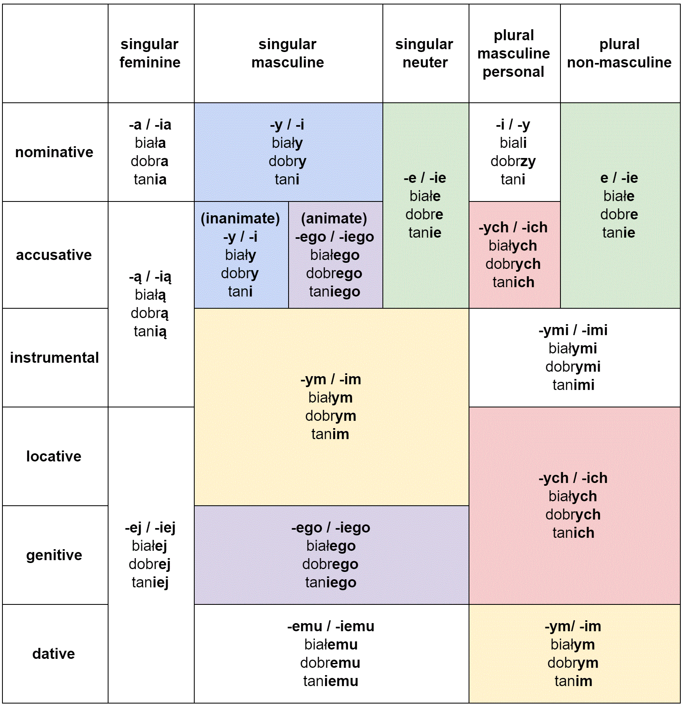
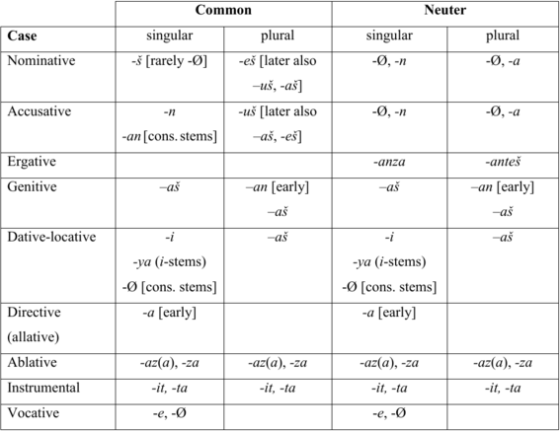

Slide 11
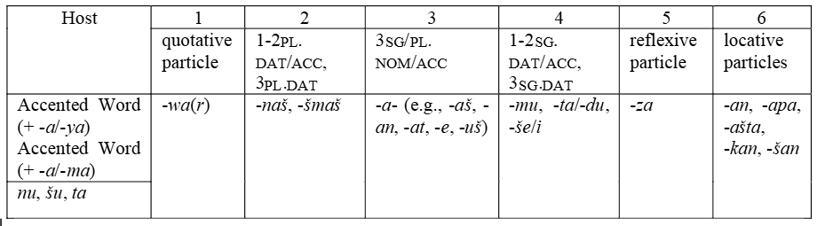
Enclitic Chains
nu=šmaš=at pe-ḫḫi
nu=war=aš=mu=kan šullāe-t
(and)=you.DAT.PL=it.ACC give-1SG.PRS
(and)=QUOT=he=me=LOC get.upstart-3SG.PST
And I will give it to youse.
“He became disrespectful to me”
ta=z ŠU^{MEŠ} arri
nu-wa-za az-zi-ik-kan-du ak-ku-us-kan-du
(and)=REFL hand-PL wash-3SG.PST
(and)=QUOT=REFL eat-3PL.IMP.PST drink-3PL.IMP.PST
He washes his hands.
“And let them(selves) eat and drink.”

Slide 12
KUB 13.4 - Bedřich Hrozný’s discovery
nu NINDA-an ezzatteni watarma ekutteni (and) bread-ACC eat-2pl.PRS water.NOM.ACC-and drink-2pl.PRES “You will eat bread and drink water.”

Slide 13
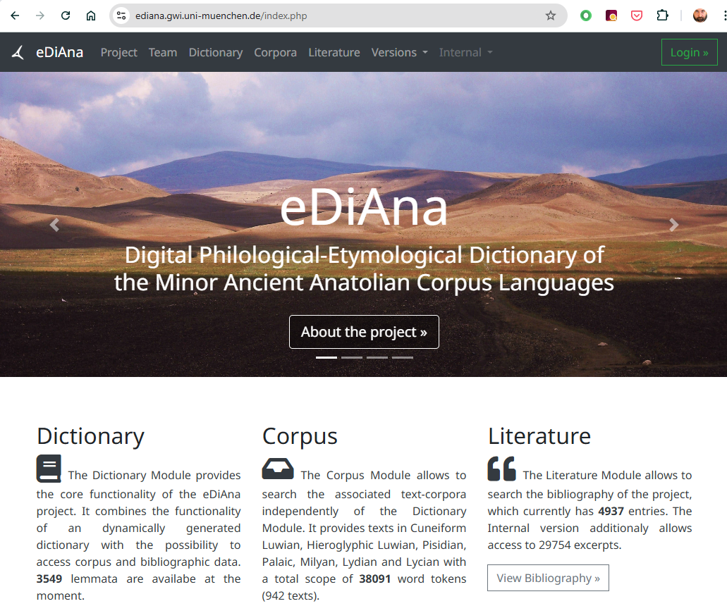
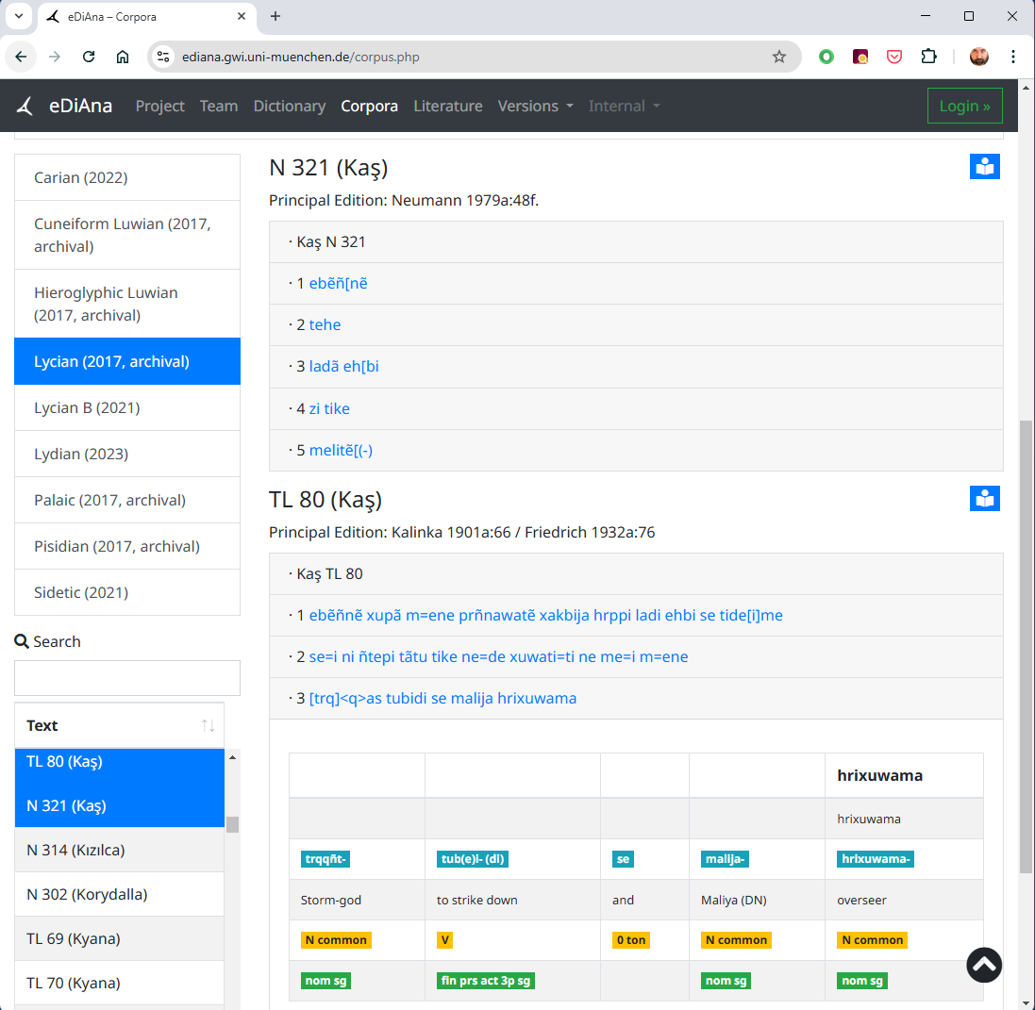
eDiAna Digital Philological-Etymological Dictionary of the Minor Ancient Anatolian Corpus Languages

Slide 14
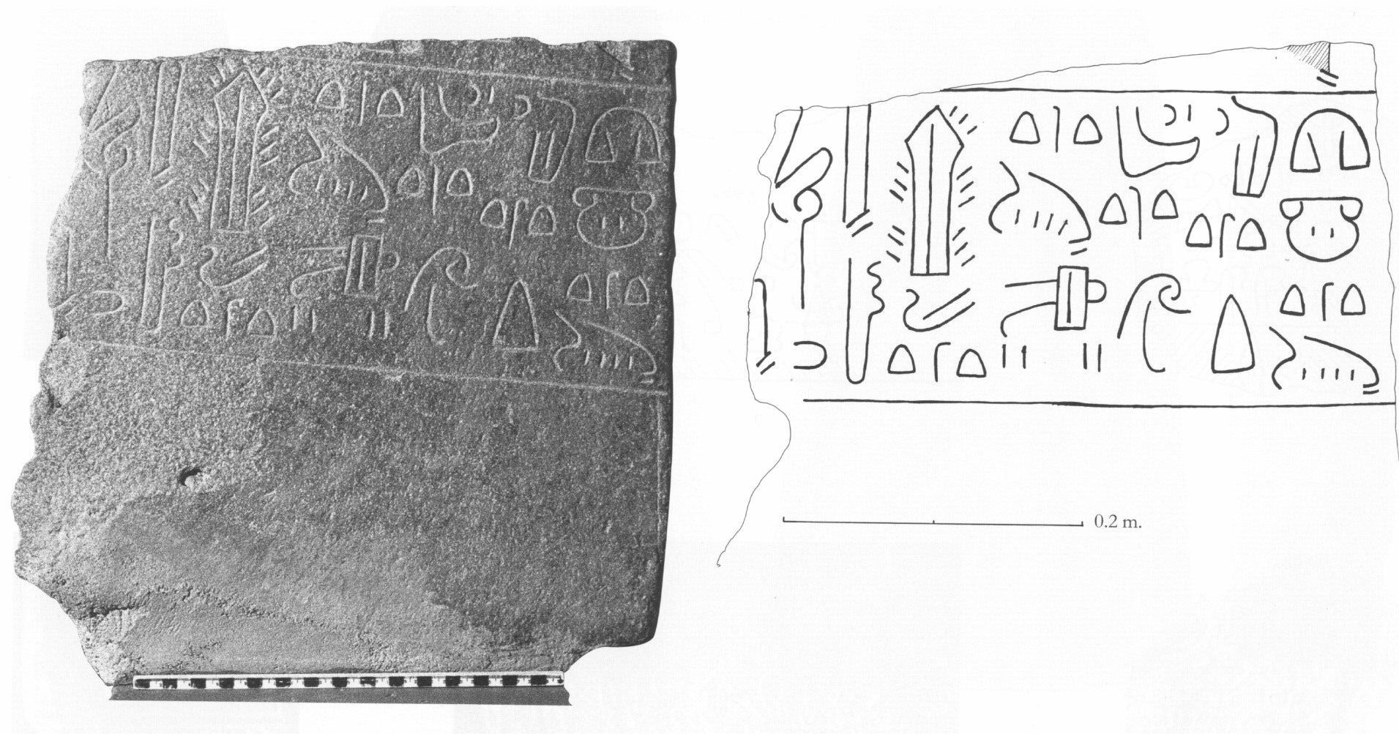
Luwian Hieroglyphic
[Tar-hun]-za¦¦-sa-pa-wa/i-mu-ta wa/i-su ¦PES-wa/i-tà
wa/i-mu OMNIS.MI BONUS-na-wa/i-ia-a CUM-ni [i-zi]-ia-[
[Tarhun]zas came well for me,
and for me [he did] all good...
Source https://www.hittitemonuments.com/
Veliisa Stele

Slide 15
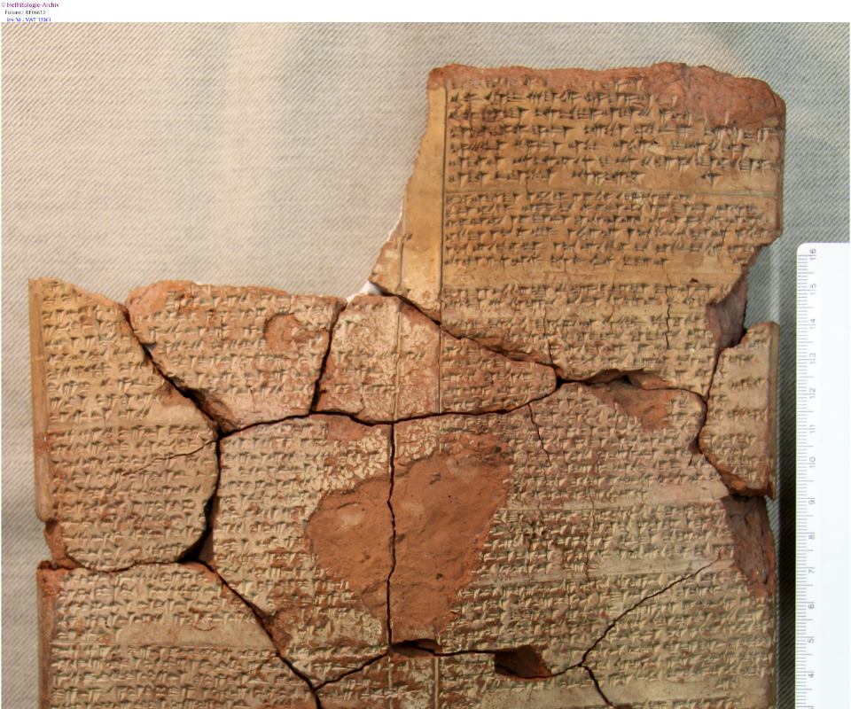
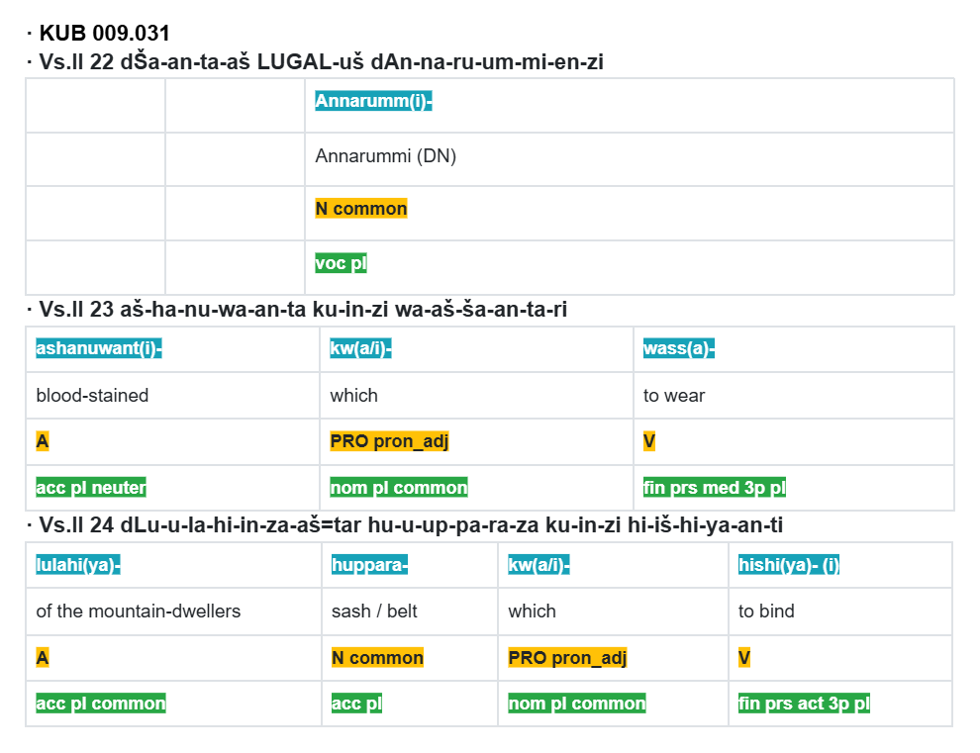
Luwian Resources
Source: eDiAna
Photograph of KUB 9.31 from HPM

Slide 16
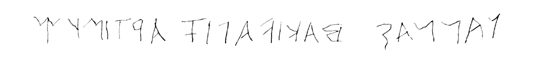
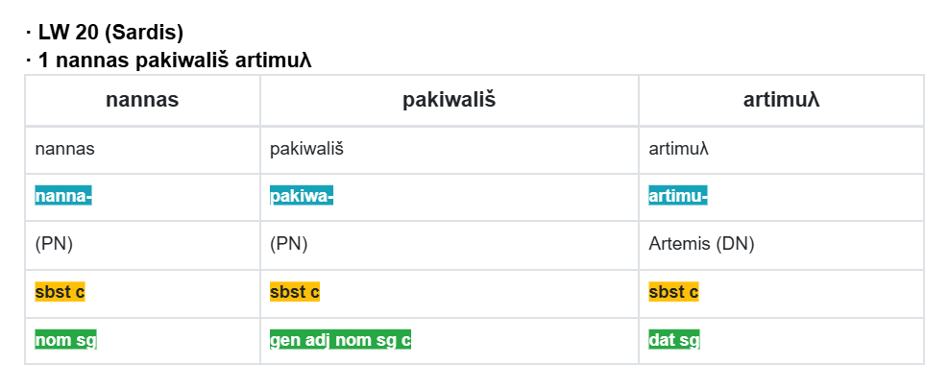
Lydian
nannas pakiwališ artimuλ
Source: ediana.gwi.uni-muenchen.de

Slide 17
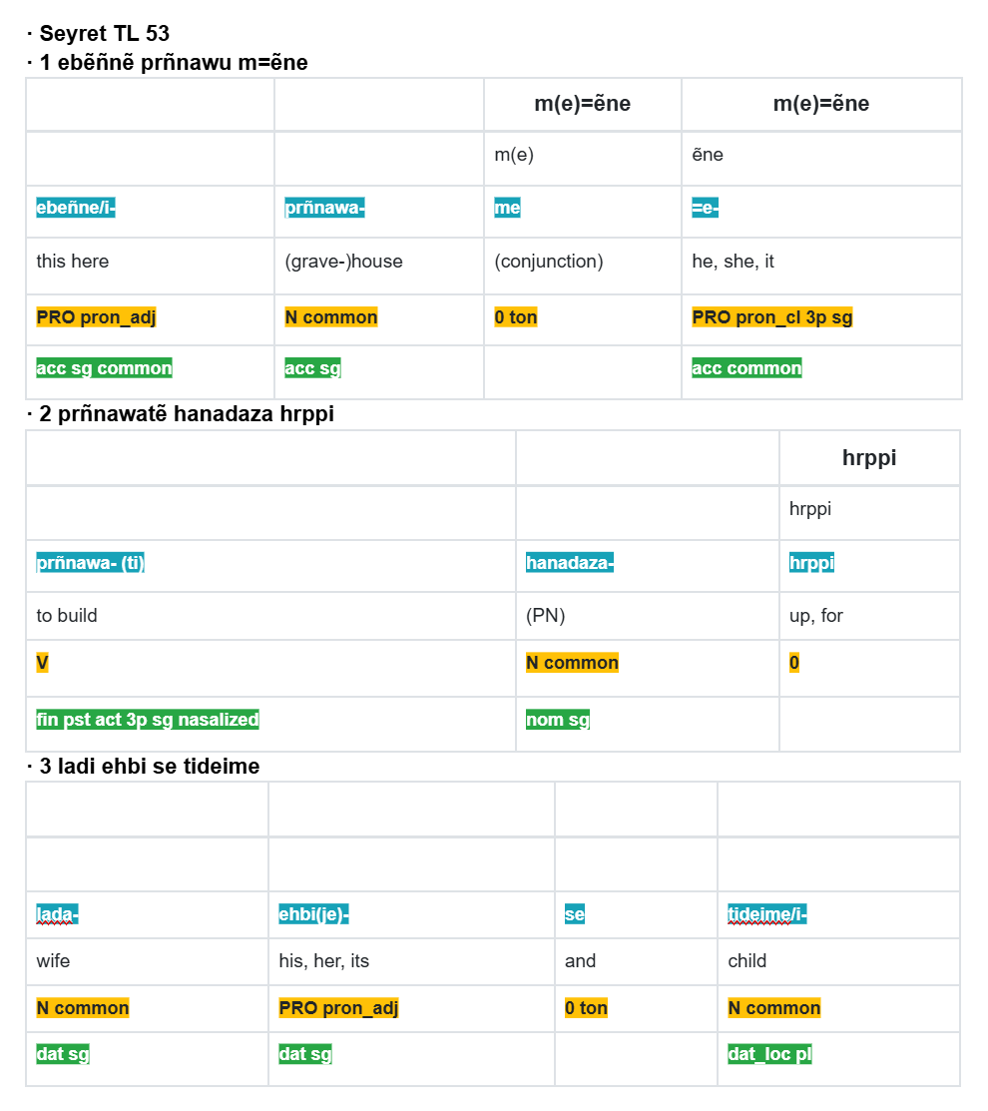
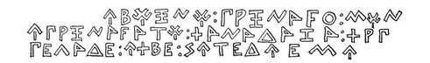
Lycian
Source: GE Bean, Lycian Turkey, 1978
ebẽñnẽ prñnawu mẽn
e prñnawatẽ hanadaza hrppi
ladi ehbi se tideime
Hanadaza built this
building for
his wife and sons.
Source: ediana.gwi.uni-muenchen.de

Slide 18
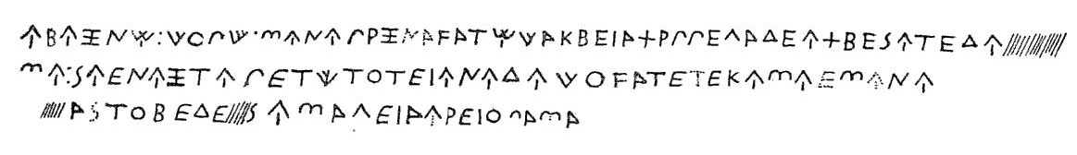
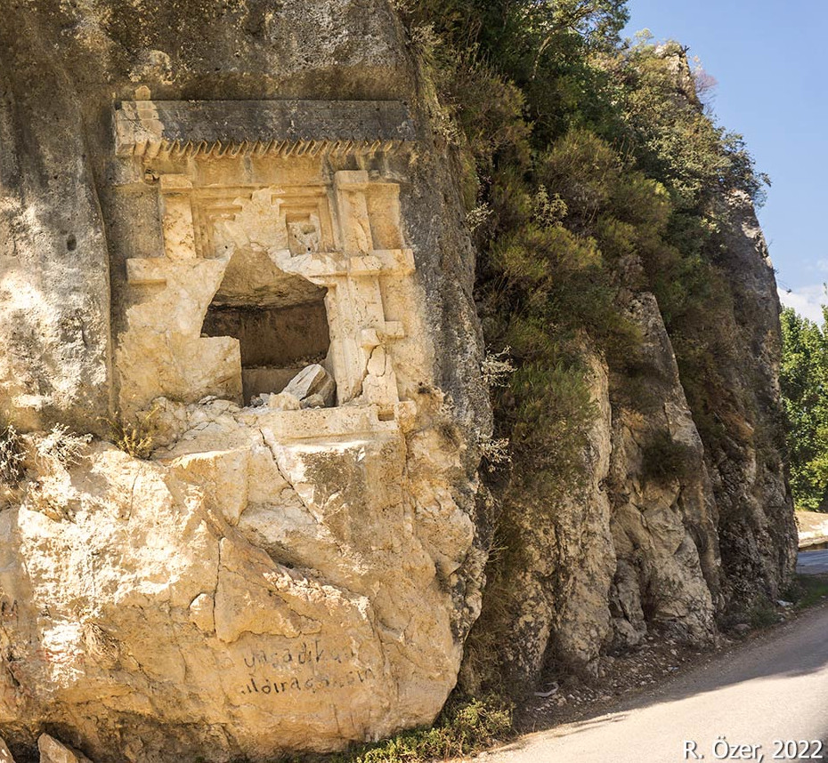
Lycian Curse - Dereağzı
ebẽñnẽ: xupã: m=ene prñnawatẽ xakbija hrppi ladi ehbi se tide[i]-
me: se=i=ni ñtepi tãtu tike ne=de xuwati=ti ne me=i m=ene
[trq]as tubidi se malija hrixuwama
This tomb has built by Xakbija for his wife and children, and anyone who places someone else will be punished by Trqqas and Malija the overseer.

Slide 19
Minor Anatolian Language Resources
Summary of eDiAna
942 texts and 38091 word tokens
287 Hieroglyphic Luwian texts
259 Cuneiform Luwian texts
187 Lycian texts
118 Lydian texts

Slide 20
Methodology (old)
Develop Treebanks for Luwian, Lycian & Lydian in the Universal Dependencies project.
Expand on the Hittite Treebank
Develop parallel sets of texts, glosses and translations
Develop language models using techniques for poorly attested languages:
SIGMORPHON 2023 Shared Task on Interlinear Glossing
ACL Special Interest Group on Computational Morphology and Phonology
RoBERTa (Liu et al., 2019)
LSTM encoder-decoders (Wada et al., 2021)
fairseq (Ott et al., 2019)

Slide 21
Research Questions
RQ1
What resources are available in a digital context for the development of
Anatolian NLP tools? What demand is there in the community of Anatolian
language scholarship for NLP tools?
RQ2
How can we improve the performance of language models at translation and
glossing tasks when working with poorly attested languages?
RQ3
Is there utility in using a cross-language embedded space to elucidate semantic
comparisons between the Anatolian languages?
RQ4
What impact do factors such as corpus size, source script type (hieroglyphic,
cuneiform, alphabetic) and language period have on the accuracy of the models’
translation and glossing performances?

Slide 22
Progress RQ1
What resources are available in a digital context for the development of Anatolian NLP tools?
Parsing of data from HPM and eDiAna sites
Sentence delineated datasets:
Lycian:
90 glossed and translated sentences (Bryce and Zahle, 1986) / eDiAna.
262 glossed, 94 translated (Bilgin 2025) / eDiAna
Hieroglyphic Luwian
135 glossed and translated sentences (Woudhuizen, 2004) and eDiAna.

Slide 23
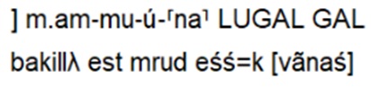
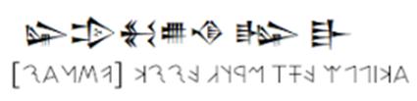
Progress RQ1
What resources are available in a digital context for the development of Anatolian NLP tools?
Melbourne Data Analytics Platform (MDAP)
External resources
Transliterated Texts
Unicode Scripts
Language Models
eDiAna, HPM etc
GPT-2, T5, ModernBERT
Collaboration benefits data quality.
Forthcoming submission for Transactions of the Association for Computational Linguistics

Slide 24
Progress RQ1
What demand is there in the community of Anatolian language scholarship for NLP tools?
Survey of Anatolian language experts
level of proficiency
current NLP projects
interest in NLP projects
willingness to share translations with CCSA NLP project

Slide 25
Progress RQ2
How can we improve the performance of language models at translation and glossing tasks when working with poorly attested languages?
External resources
Transliterated Texts POS tagging
Word-wise translations
Training and Test sets
Language Models
eDiAna, HPM etc
GPT-2, RoBERTa ModernBERT

Slide 26
RQ2: Morphological Glossing Task Results
# N 303 (Phellos) 3 \t ebeija arawazija me ti prñnaw[atẽ] arñnas xtt.ahe
\g
['PRON-ACC.COM.PL', 'NOUN-DAT-LOC.COM.PL', '-', 'PRON-NOM.COM.SG', 'VERB-SG.3P.PST.FIN.ACT', 'NOUN-NOM.COM.SG', 'ADJ-NOM.COM.SG']
# N 303 (Phellos) 3 \t ebeija arawazija me ti prñnaw[atẽ] arñnas xtt.ahe
\g PRON-ACC.COM.PL NOUN-ACC.NEUT - PRON-NOM.COM.SG VERB-SG.3P.PST.FIN.ACT NOUN-NOM.COM.SG NOUN-GEN.COM.SG

Slide 27
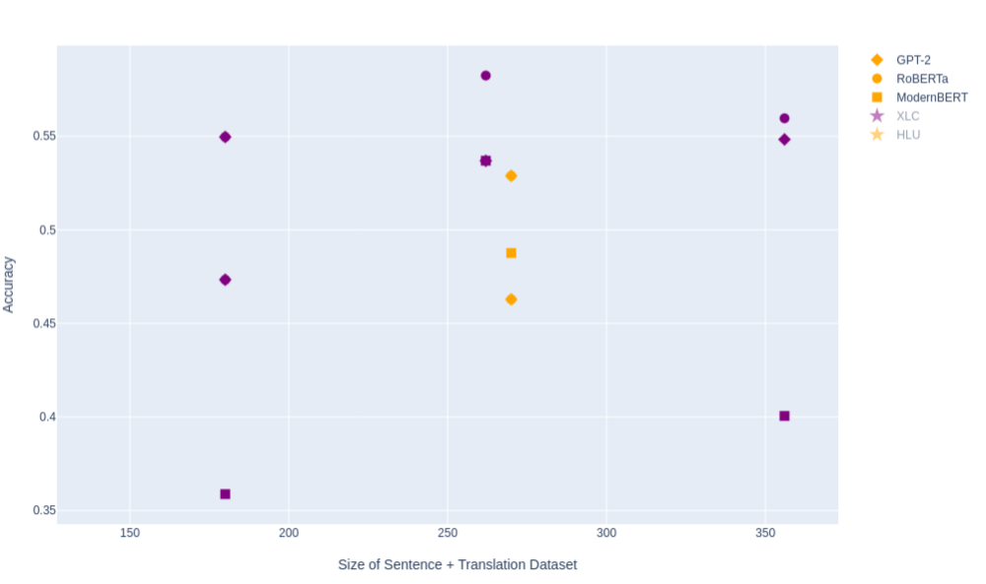
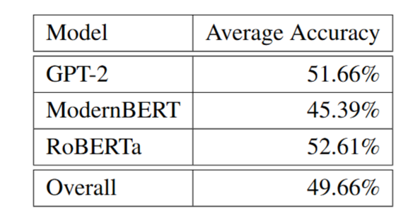
RQ2: Morphological Glossing Task Results

Slide 28
RQ2 Further Work
Morphological Glossing Task
Increasing the number of sentences in the domain.
Examining whether glossing conventions are consistent within the training set.
Cleaning the source sentences to remove epigraphic annotations for textual uncertainty, lacunae and reconstructions.
Cleaning the translated sentences to remove remarks about uncertainty or other interlinear commentary by the translator.
Tuning model parameters in order to optimise performance.
Using pre-trained weights with models from existing languages.
Translation task
Long Short-Term Memory encode-decoder
Wada et al 2021
Learning Contextualised Cross-lingual Word Embeddings and Alignments for Extremely Low-Resource Languages Using Parallel Corpora
Pre-Trained Models such as T5 or GPT-4.

Slide 29
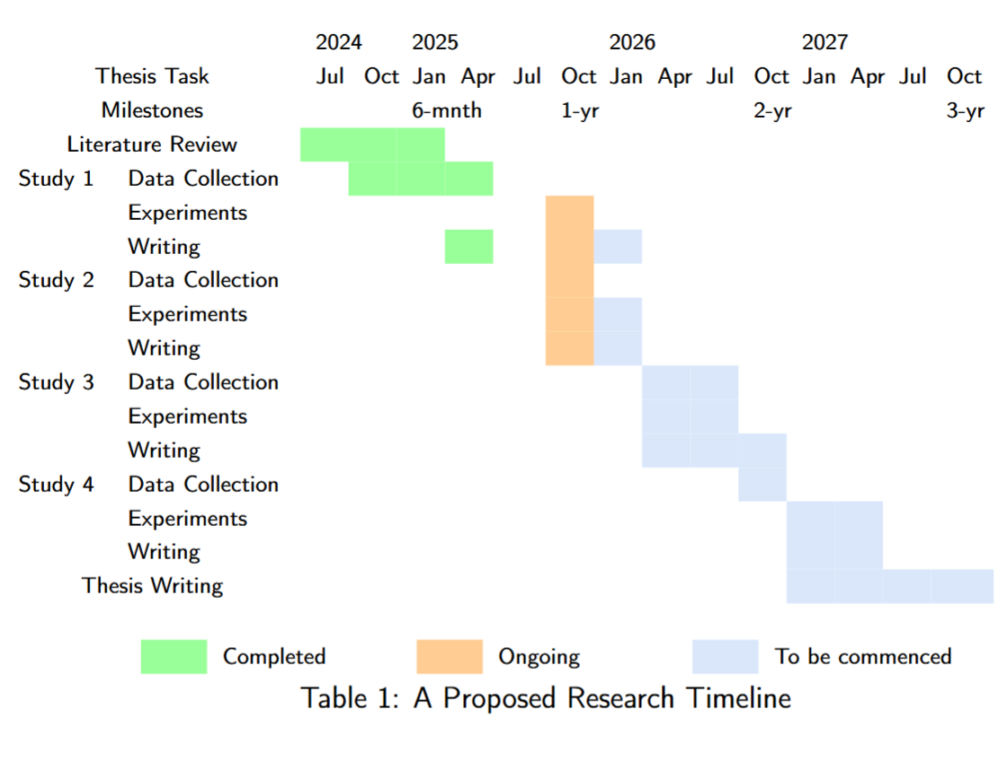
Proposed Research Timeline

Slide 30
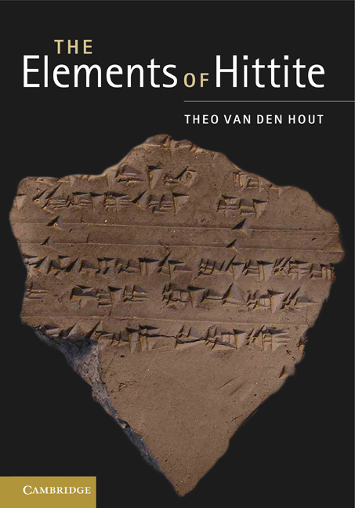
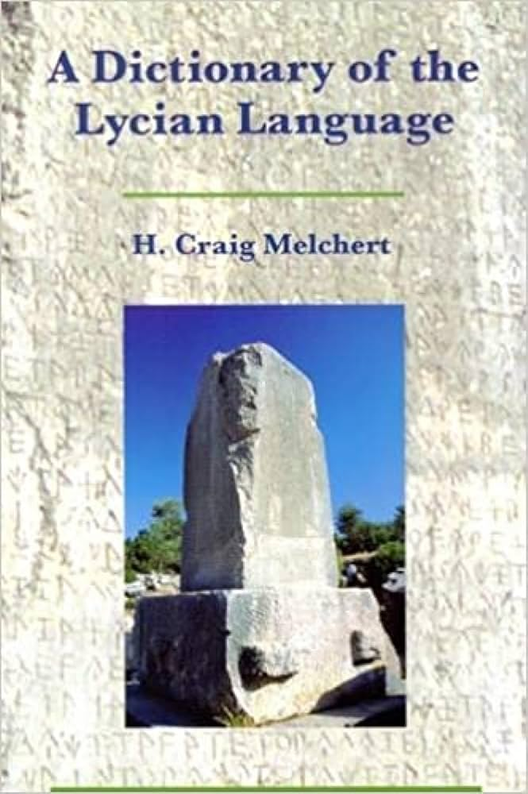
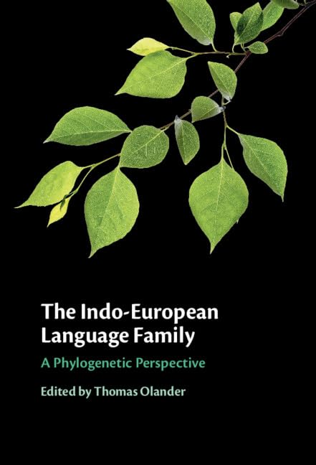
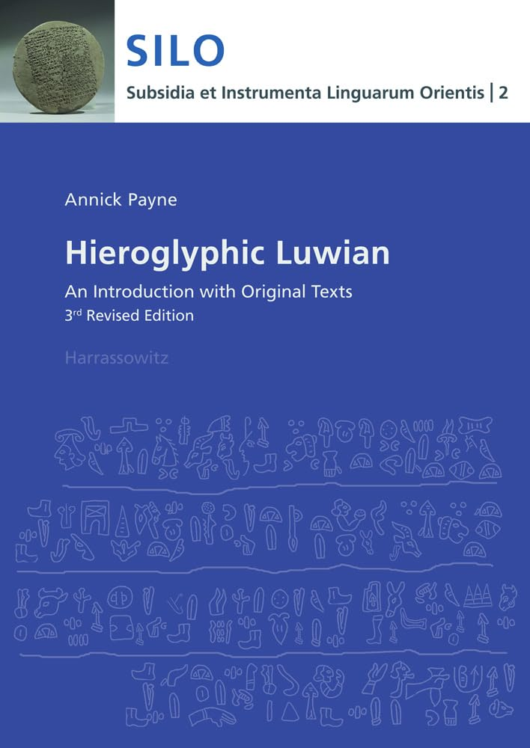
References
Hetitologie Portal Mainz - hethport.uni-wuerzburg.de
eDiAna - ediana.gwi.uni-muenchen.de

